Slide 1
XML Schema
Xml Schema Documents

Slide 2
Drawbacks of DTD
Syntax is not XML and so XML parsers cannot parse them into component parts very easily.
Weak Data types.
Not modular so cannot be reusable.
Not easily extensible. (No inheritance in DTD)
Notes:
DTDs are written in EBNF (Extended Backus-Naur Form) notation.
XML Schema are replacement for DTD. XML schemas are intended to give XML all these features

Slide 3
XML Schema
XML schema is used to describe structure of the data in XML document and it overcomes several disadvantages of DTD.
Supports
  More data types
  Is XML document
  Extensible
  Modular
The XML Schema language is also referred to as XML Schema Definition (XSD).
Notes:
Extensible : ability to use parts of schema in other schemas, ability to define complex structures that can be reused
Modular: creating reusable constructs.

Slide 4
Numeric types
integer Examples: 45
nonPositiveInteger, negativeInteger, nonNegativeInteger, positiveInteger
byte(8 bits),short(16 bits),int(32 bits),long (64 bits)
unsignedLong, unsignedInt, unsignedShort, unsignedByte
number(18 decimal places) Examples: 1.1,.8,9.5,6,8.7E3
float (32-bit)
double(64-bit)Examples:-INF,INF,8.7E3, 1.1,NaN
decimal for all numeric types

Slide 5
String types
string (no whitespace normalization is done) Examples: hello world
normalizedString (whitespace replaced by #x20)
token (Whitespaces are normalized)
language (accept all the language codes standardized by RFC 1766) Examples: us-en, en
NMTOKEN (a single name token composed of characters allowed in an XML name) Examples: “ABC", “2010-01-15"
NMTOKENS (whitespace-separated lists of NMTOKEN components)
Name (similar to NMTOKEN with the additional restriction that the values must start either with a letter or the characters ":" or "_".)
Notes:
whitespaces are normalized: all the sequences of whitespaces are replaced by a single space, and the leading and trailing spaces are removed.
Invalid xml names:” Peanuts strip" , "bold,brash"

Slide 6
String types
NCName ( noncolonized name)
ID (same as NCName and here must not be any duplicate values in a document
IDREF (it must match an ID defined in the same document)
IDREFS (whitespace-separated list of NCName values)
ENTITY(same as NCName, provided for compatibility)
ENTITIES (value spaces of ENTITIES are the whitespace-separated lists )
Notes:
noncolonized name :a Name without any colons

Slide 7
Date Types
dateTime (yyyy-mm-ddThh:mm:ss) Examples: 2010-01-10T16:30:34
date(yyyy-mm-dd) Same as datetime with an optional time zone (Examples: 2010-01-11, 2010-01-11+12:00 .
duration (PnYnMnDTnHnMnS) Each part (except the leading "P") is optional. Example: P2Y3M8DT100S
time (hh:mm:ss) Example: 6:30:34
gYearMonth Examples: 2010-10,2010-10+02:00, or 2010-10Z)
gYear Examples 2010, 2010+02:00or 2010Z
gDay (---DD), gMonthDay( --MM-DD ), gMonth(--MM or --MM--)
Notes:
P2Y3M8DT100S: which means a duration of 2 year, 3 months, 8 days and 100 seconds
date(yyyy-mm-dd) Same as datetime with an optional time zone and represents a period of one day in its time zone, "independent of how many hours this day has."The consequence of this definition is that two dates defined in a different time zone can't be equal, except if they designate the same interval (2010-01-11+12:00 and 2010-01-10-12:00, for instance).

Slide 8
Other types
boolean (Legal values for boolean are true, false, 1 (which indicates true), and 0 (which indicates false).
base64Binary (Base64-encoded binary data)
hexBinary (hexadecimal-encoded binary data)
anyURI Example: http://www.xyz.com/home.html

Slide 9
Declaring elements
Simple form:
  <xsd:element name=“IssueDate” />
With type specified:
  <xsd:element name=“IssueDate” type=“xsd:date” />
With number of times element can occur:
  <xsd:element name=“IssueDate” type=“xsd:date” minOccurs=“0” maxOccurs=“1” />
→In XML:
<IssueDate>2007-05-25</IssueDate>

Slide 10
minOccurs, maxOccurs
minOccurs, maxOccurs can have any non-negative integer.
maxOccurs can take a special value → unbounded : which means that the element must occur at least minOccurs times but there is no upper limit on how many times it can occur.
If minOccurs is specified and maxOccurs is omitted, the value of maxOccurs = minOccurs.

Slide 11
<xs:schema>
Root element of all XML Schema document.
Example :<xs:schema xmlns:xs="http://www.w3.org/2001/XMLSchema" elementFormDefault="qualified">
Could also have targetNamespace and xmlns attributes
An XML document can reference a Schema through xsi:schemaLocation attribute of the root tag.
Notes:
xmlns:xs: elements and data types used in the schema come from the "http://www.w3.org/2001/XMLSchema
targetNamespace:the elements defined by this schema
Xmlns: default namespace is "http://www.w3schools.com".
elementFormDefault="qualified"indicates that any elements used by the XML instance document which were declared in this schema must be namespace qualified.

Slide 12
Simple atomic type
XML:
<name>Mocha Java</name>
<price>11.95</price>
XSD:
<xs:element name=“name" type="xs:string"/>
<xs:element name=“price" type="xs:double"/>
Default Values: <xs:element name=“size" type="xs:int" default=“12"/>
Fixed Values: <xs:element name=“size" type="xs:int" fixed=“12"/>
In the same way attributes can also be defined by <xs:attribute>
Attributes are optional by default. To specify that the attribute is required →<xs:attribute name=“code" type="xs:string" use="required"/>

Slide 13
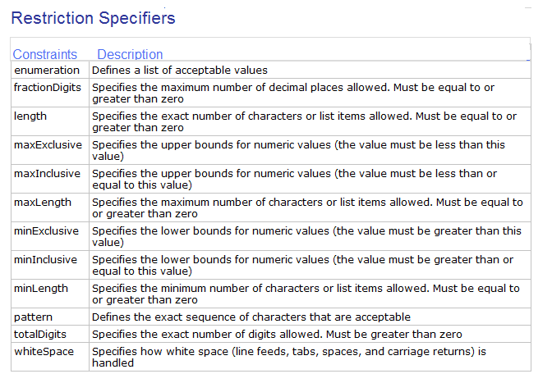
Restricting values

Slide 14
Examples
<xs:element name=“shirtSize">
<xs:simpleType>
<xs:restriction base="xs:int">
<xs:enumeration value=“36"/>
<xs:enumeration value=“40"/>
<xs:enumeration value=“42/>
<xs:enumeration value=“44/>
</xs:restriction>
</xs:simpleType>
</xs:element>
<xs:element name=“empage">
<xs:simpleType>
<xs:restriction base="xs:integer">
<xs:minInclusive value=“20"/>
<xs:maxInclusive value=“60"/>
</xs:restriction>
</xs:simpleType>
</xs:element>
Restrict the sizes to 36 40 42 44
Employment Age between 20 and 60

Slide 15
<xs:element name="initials">
<xs:simpleType>
<xs:restriction base="xs:string">
<xs:pattern value="[a-zA-Z][a-zA-Z][a-zA-Z]"/>
</xs:restriction>
</xs:simpleType>
</xs:element>
Country code with three letters only either in upper or lower case
<xs:element name="letter">
<xs:simpleType>
<xs:restriction base="xs:integer">
<xs:pattern value="([0-9])*"/>
</xs:restriction>
</xs:simpleType>
</xs:element>
Any integer, no value is also acceptable

Slide 16
<xs:element name="letter">
<xs:simpleType>
<xs:restriction base="xs:integer">
<xs:pattern value="([0-9])+"/>
</xs:restriction>
</xs:simpleType>
</xs:element>
Any integer
<xs:element name="gender">
<xs:simpleType>
<xs:restriction base="xs:string">
<xs:pattern value="male|female"/>
</xs:restriction>
</xs:simpleType>
</xs:element>
<xs:element name="password">
<xs:simpleType>
<xs:restriction base="xs:string">
<xs:pattern value="[a-zA-Z0-9]{8}"/>
</xs:restriction>
</xs:simpleType>
</xs:element>
Password consisting of 8 chars containing letters or digits

Slide 17
<xs:element name="password">
<xs:simpleType>
<xs:restriction base="xs:string">
<xs:length value="8"/>
</xs:restriction>
</xs:simpleType>
</xs:element>
<xs:element name=“date">
<xs:simpleType>
<xs:restriction base="xs:string">
<xs:minLength value="5"/>
<xs:maxLength value="8"/>
</xs:restriction>
</xs:simpleType>
</xs:element>

Slide 18
List type
List type can be created form an existing list of strings or integers separated by spaces specified as simple type.
Example:
XML: <sizes>23 32 36 40 42 44</sizes>
XSD:
<xsd:simpleType name=“sizes”>
<xsd:list itemType=“shirtSize” />
</xsd:simpleType>
  where shirtSize may be defined as
  Enumerated restricted values (1st example o “Restricting values” )

Slide 19
Union Types
Union Types enable element content or attribute values to be of a type provided from a union of different simple and list types.
XML:
<sizes>20 23 32 36 40</sizes>
<sizes>S M L XL XXL</sizes>
<xsd:simpleType name=“sizesUnion”>
<xsd:union memberTypes=“sizes letter”/>
</xsd:simpleType>
Where sizes is defined as in previous slide and letter may be defined similarly

Slide 20
User-defined types/complex types
<xsd:complexType name=“Address”>
<xsd:sequence>
<xsd:element name=“Street” type="xs:string"/>
<xsd:element name=“City” type="xs:string" />
<xsd:element name=“State” type="xs:string" />
<xsd:element name=“Country” type="xs:string" />
<xsd:element name=“PIN” type="xs:pin" />
</xsd:sequence>
</xsd:complexType>
Can you define the XSD for pin?
Elements must appear in the order in which they are declared

Slide 21
Using complex types
<xsd:element name=“MailAddress” type=“Address” />
<xsd:element name=“BillingAdd” type= “Address”/>
In XML
<MailAddress>
<Street>Gangarams Book Bureau, M.G Road</Street>
<City>Bangalore</City>
<State>Karnataka</State>
<Country>India</Country>
<PIN>560001</PIN></MailAddress>

Slide 22
Sequence Content Type
An element content can be defined as containing a sequence of other elements.
  <xsd:element name=“MailAddress”>
  <xsd:complexType>
  <xsd:sequence>
  <xsd:element name=“Street”/>
  <xsd:element name=“City”/>
  <xsd:element name=“State”/>
  <xsd:element name=“Country”/>
  <xsd:element name=“PIN”/>
  </xsd:sequence>
  </xsd:complexType> </xsd:element>
The <xsd:sequence> specifies that the child elements must appear in a specific order
Notes:
If address element appears only once then we need not create an address data type.

Slide 23
<xsd:anyType>
Any
<xsd:element name=“XXX” type=“xsd:anyType”/>

Slide 24
Complex Empty Elements
XML:
<Line width=“10”>
XSD:
  <xs:element name=“Line">
  <xs:complexType>
  <xs:complexContent>
  <xs:restriction base="xs:integer">
  <xs:attribute name=“width" type="xs:positiveInteger"/>
  </xs:restriction>
  </xs:complexContent>
  </xs:complexType>
  </xs:element>
Notes:
Compact way of declaration: <xs:element name="product">
<xs:complexType>
<xs:attribute name="prodid" type="xs:positiveInteger"/>
</xs:complexType>
</xs:element>

Slide 25
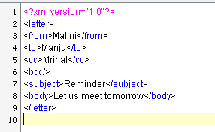
Complete Example
XML
Schema for this …
Notes:
<!ELEMENT letter (to, from, subject, body)>
<!ELEMENT to (#PCDATA)>
<!ELEMENT from (#PCDATA)>
<!ELEMENT subject (#PCDATA)>
<!ELEMENT body (#PCDATA)>

Slide 26
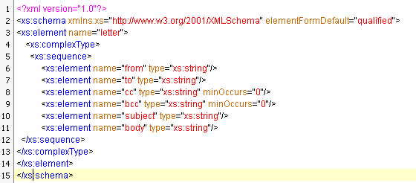
XSD

Slide 27
Question?
Create a complex type for FullName consisting of FirstName, MiddleName and LastName where MiddleName is optional.
Notes:
<xsd:complexType name=“FullName”>
<xsd:sequence>
<xsd:element name=“First Name”/>
<xsd:element name=“MiddleName” minOccurs=“0” maxOccurs=“1”/>
<xsd:element name=“LastName”/>
</xsd:sequence>
</xsd:complexType>

Slide 28
ref
An element which is defined else where in the schema document can be used elsewhere by using ref attribute.
For instance consider element called ‘phone’ defined as below
  <xsd:element name=“phone”>
  <xsd:complexType>
  <xsd:element name=“mobile” type=“unsignedLong” minOccurs=“0” maxOccurs=“1”/>
  <xsd:element name=“res” type=“unsignedLong” minOccurs=“0” maxOccurs=“1”/>
  <xsd:complexType>
  </xsd:element>

Slide 29
This element can be referenced anywhere in the schema document like shown below:
<xsd:element name=“addressBook”>
  <xsd:complexType>
  <xsd:element name=“name”/>
  <xsd:element ref=“phone”/>
  <xsd:complexType>
  </xsd:element>

Slide 30
Declaring Attributes
Simple Attribute
<xsd:attribute name=“href” />
Attribute with data type
<xsd:attribute name=“border” type=“boolean” />
Attribute with use→required, optional, prohibited
<xsd:attribute name=“width” use=“optional” />
Attribute with fixed or default content
<xsd:attribute name=“paid” use=“required” fixed=“True” />
<xsd:attribute name=“paid” use=“optional” default=“True” />

Slide 31
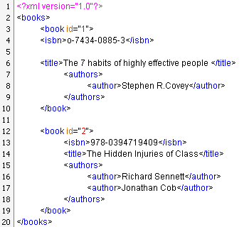
XSD for this →

Slide 32
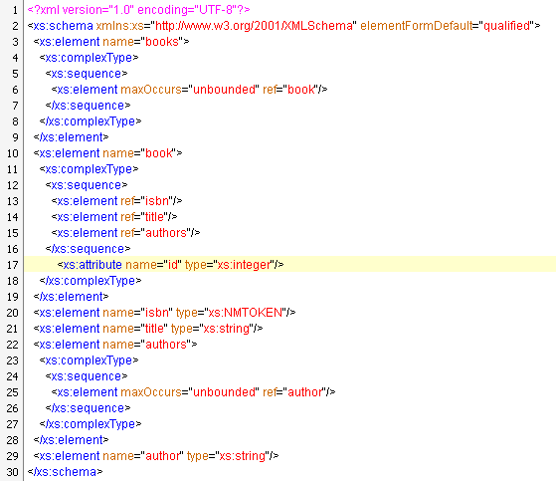

Slide 33
Elements in any order
<xs:all> specifies that
  the child elements can appear in any order
  each child element must occur only once
<xs:element name=“employee">
<xs:complexType>
<xs:all>
<xs:element name=“fname" type="xs:string"/>
<xs:element name=“lname" type="xs:string"/>
</xs:all>
</xs:complexType>
</xs:element>
Notes:
When using the <all> indicator you can set the <minOccurs> indicator to 0 or 1 and the <maxOccurs> indicator can only be set to 1 (the <minOccurs> and <maxOccurs> are described later).

Slide 34
Extending Complex Types
A complex type can be extended to include another element thus creating new types.
This is a way by which we can reuse existing structure to build larger structures.
Example:
<xsd:element name=“ContactDetails”>
<xsd:complexType>
<xsd:complexContent>
<xsd:extension base=“Address”>
<xsd:attribute name=“entrydt” type=“xsd:date” /> </xsd:extension>
</xsd:complexContent>
</xsd:complexType></xsd:element>
Notes:
<!-- creating user defined complex data datatype the same can be used in elements-->
<xs:complexType name="Address">
<xs:sequence>
<xs:element name="Street" type="xs:string"/>
<xs:element name="City" type="xs:string"/>
<xs:element name="State" type="xs:string"/>
<xs:element name="Pin" type="xs:integer"/>
</xs:sequence>
</xs:complexType>
<xs:element name="PassportAddress">
<xs:complexType>
<xs:complexContent>
<xs:extension base="Address">
<xs:sequence>
<xs:element name="verified" type="xs:string"/>
</xs:sequence>
</xs:extension>
</xs:complexContent>
</xs:complexType>
</xs:element>

